Slide 1
OpenGL Final Presentation
Ajil Pappachan
L5 GMD

Slide 2
Finalised Idea - Fortress

Slide 3
Overview
Fortress is a modified version of the skyscraper idea
Instead of a skyscraper, the main model is a fortress or castle

Slide 4
Reasons for finalising
Possible to make use of several OpenGL functionalities
Received most positive reviews

Slide 5
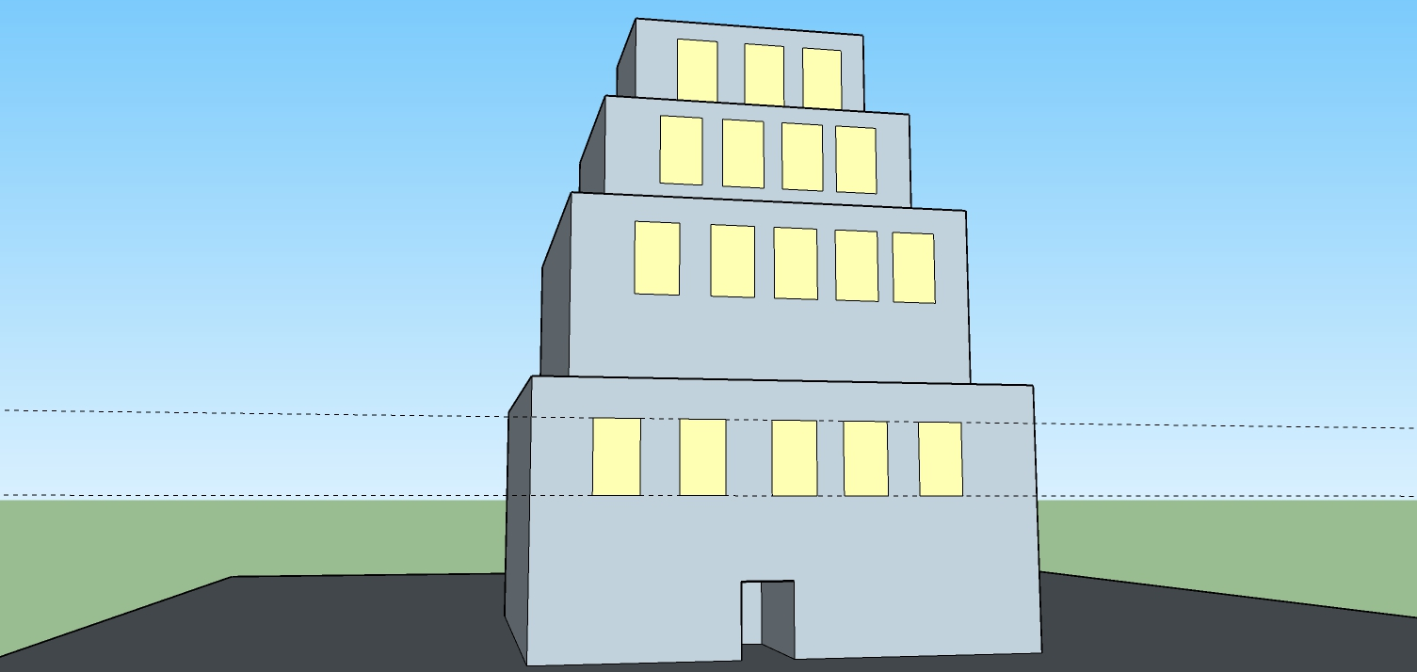
Original Mock-Up

Slide 6
New Functionalities Explored
Textures
Model Loading
Transformations
Skybox

Slide 7
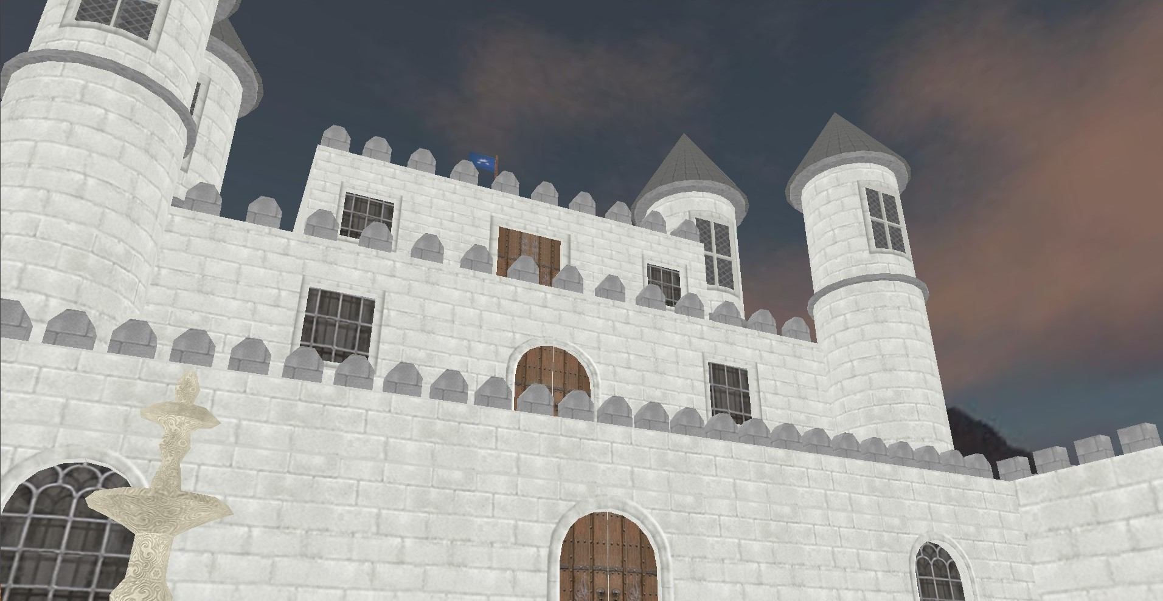
Final Design

Slide 8
Tools Used
OpenGL (Visual Studio)
GLFW
GLEW
GLM
SOIL2
Assimp
IrrKlang
Skybox
3D Models

